Slide 1
Recursively Enumerable and
Recursive Languages

Slide 2
Turing Machine
There are three possible outcomes of executing a Turing machine over a given input.
The Turing machine may
Halt and accept the input
Halt and reject the input
Never halt. (loops for ever)

Slide 3
Definition:
A language is recursively enumerable
if there is a Turing machine that accepts it
Also known as: Turing Recognizable languages
orTuring Acceptable languages

Slide 4





Let be a recursively enumerable language
and the Turing Machine that accepts it
For any string :
if
then halts in an accept state
if
then halts in a non-accept state
or loops forever

Slide 5
Definition:
A language is recursive
if there is a Turing machine accepts it
and the machine halts on every input string
Also known as decidable languages

Slide 6
Let be a recursive language
Then there is a Turing machine
that accepts such that:
For any string :
if
then halts in an accept state
if
then halts in a non-accept state

Slide 7
Non Recursively Enumerable
Recursively Enumerable
Recursive

Slide 8
Decidable & Undecidable
Language L is Decidable if it is a recursive language.
It is Undecidable if it not a recurisve language

Slide 9
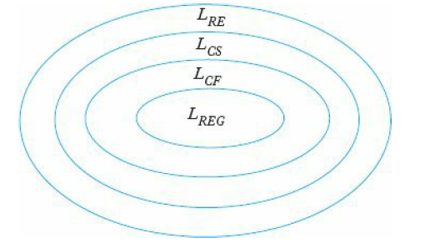
Chmosky Hierarchy

Slide 10
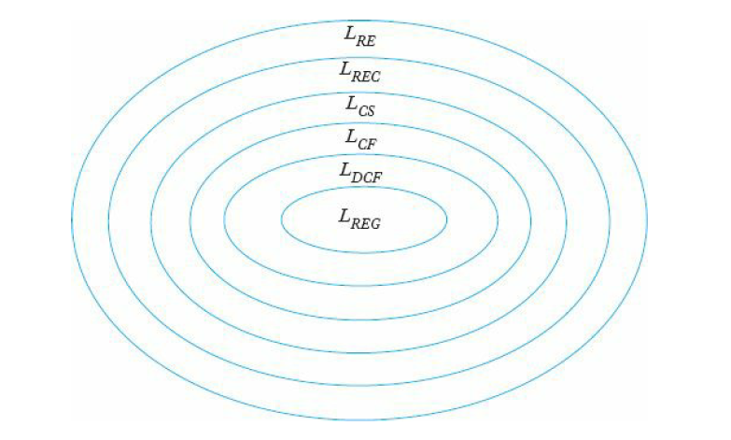
Chmosky Hierarchy

Slide 11
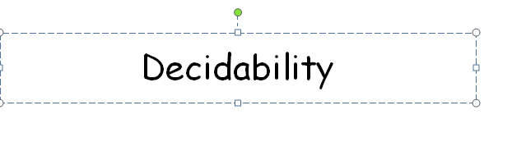

Slide 12
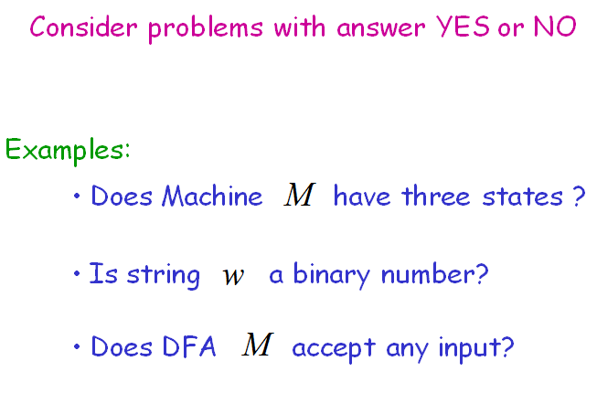

Slide 13
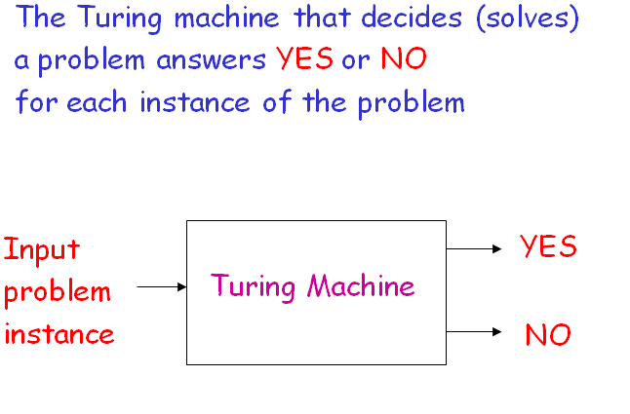

Slide 14
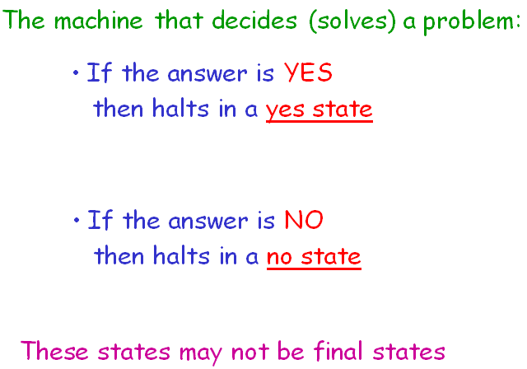

Slide 15
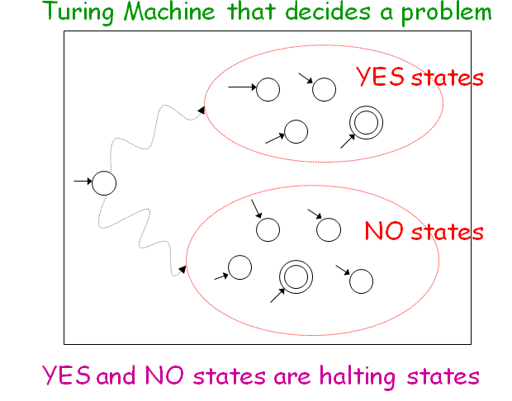

Slide 16
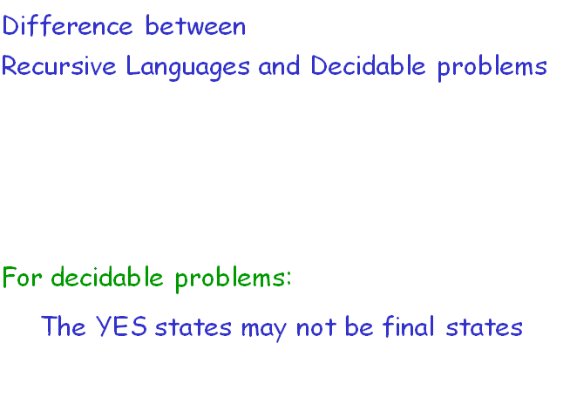

Slide 17
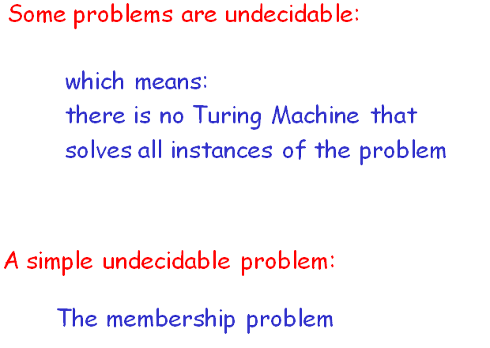

Slide 18
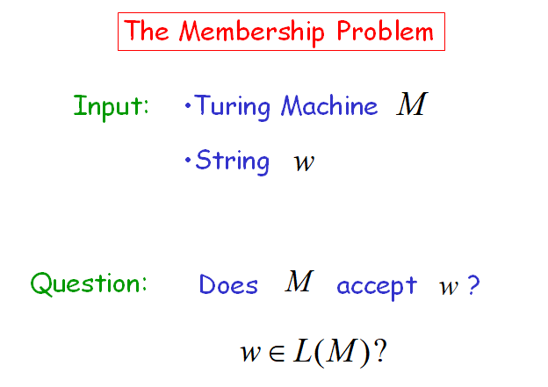

Slide 19
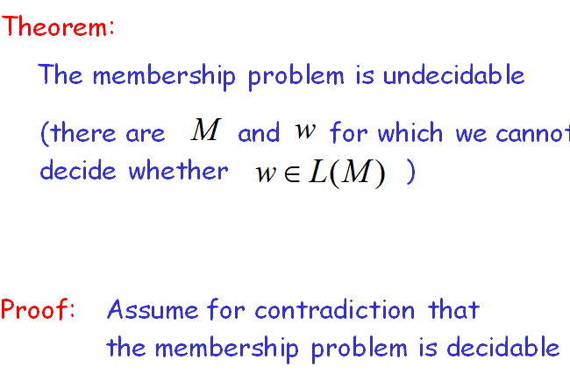

Slide 20
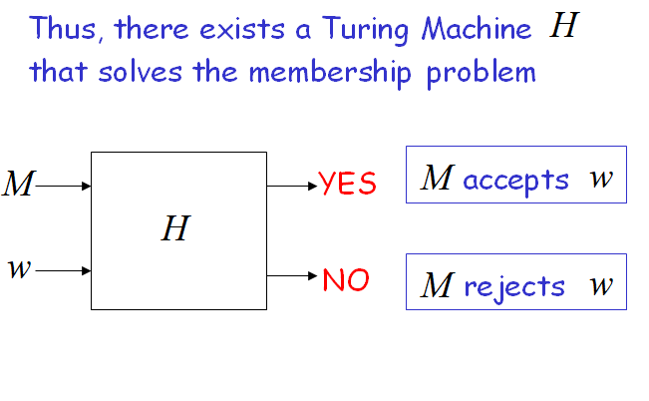

Slide 21
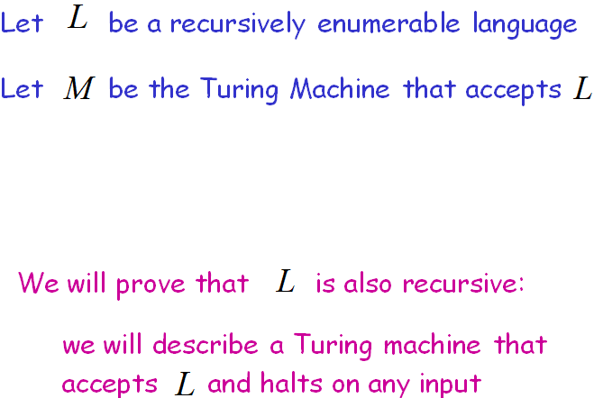

Slide 22
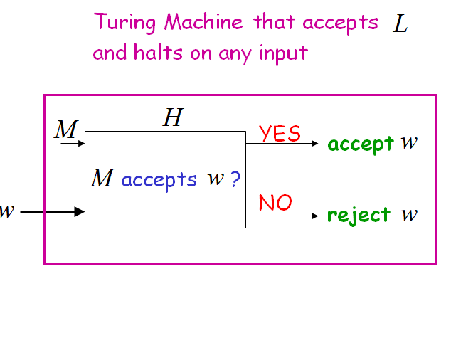

Slide 23
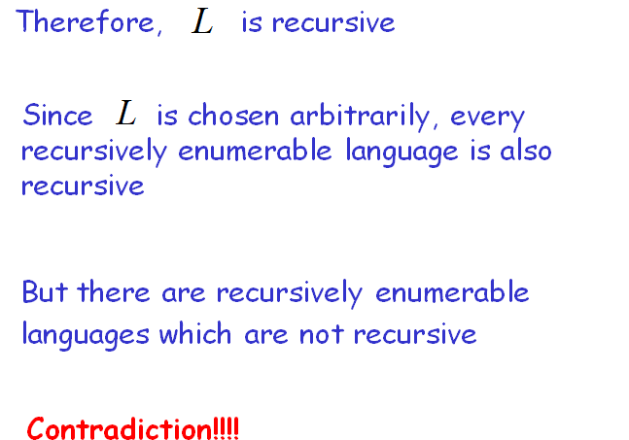

Slide 24
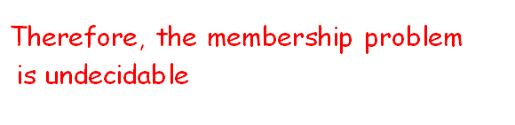

Slide 25
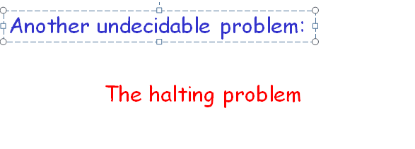

Slide 26
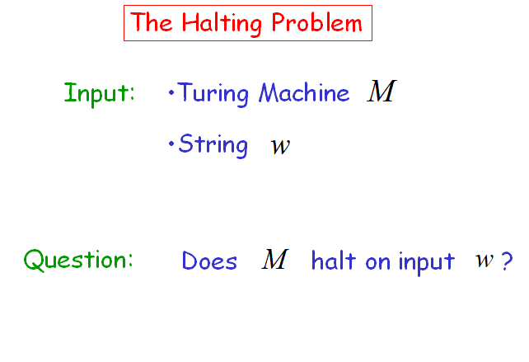

Slide 27
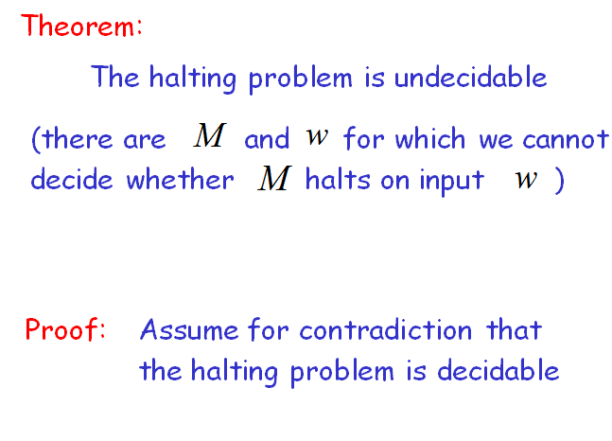

Slide 28
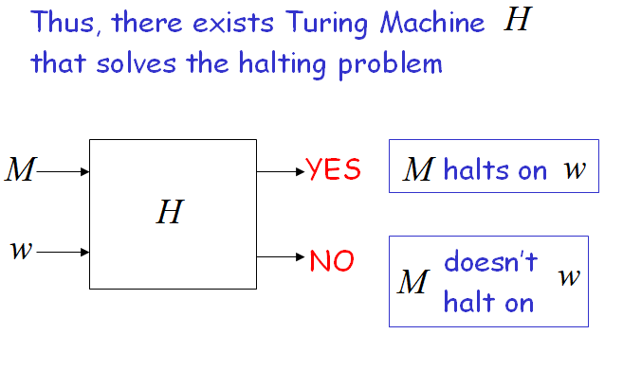

Slide 29
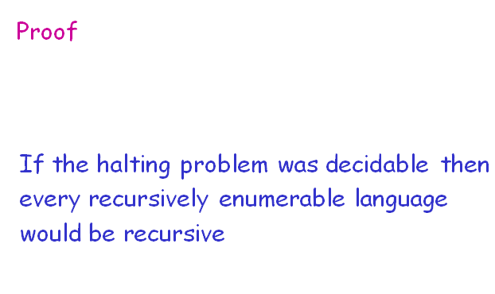

Slide 30
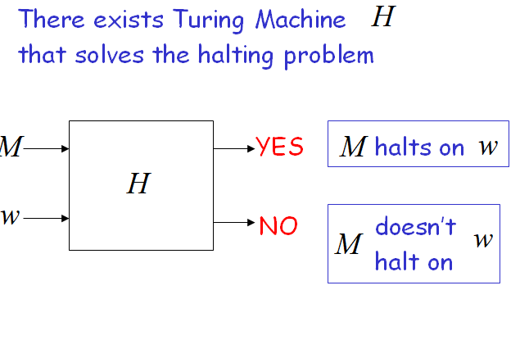

Slide 31
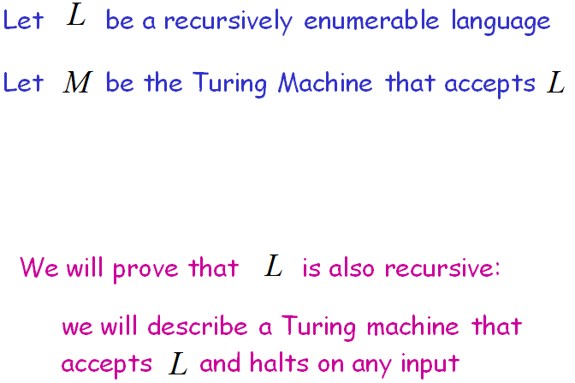

Slide 32
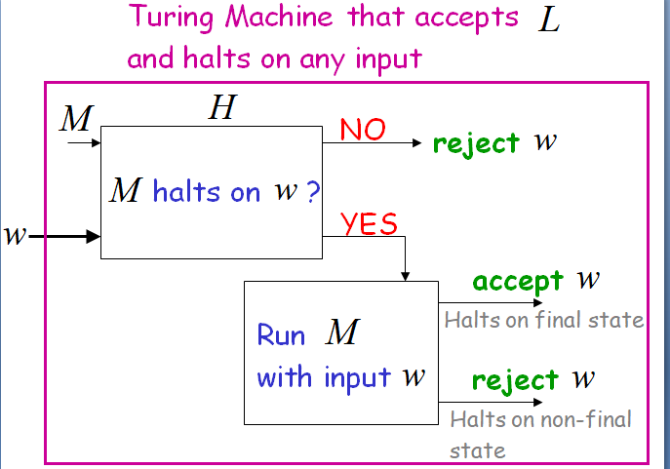

Slide 33
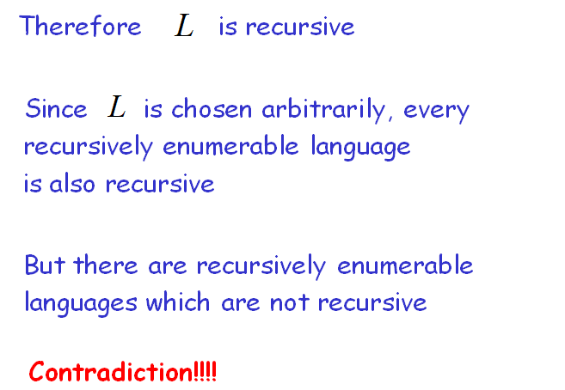

Slide 34


Slide 35
Recursively enumerable languages are also known as type 0 languages.
Context-sensitive languages are also known as type 1 languages.
Context-free languages are also known as type 2 languages.
Regular languages are also known as type 3 languages.

Slide 36
Definition: Let L be a language. Then L is recursively enumerable if there exists a TM M such that L = L(M).
  If L is r.e. then L = L(M) for some TM M, and
    If x is in L then M halts in a final (accepting) state.
    If x is not in L then M may halt in a non-final (non-accepting) state or no transition is available, or loop forever.
Definition: Let L be a language. Then L is recursive if there exists a TM M such that L = L(M) and M halts on all inputs.
  If L is recursive then L = L(M) for some TM M, and
    If x is in L then M halts in a final (accepting) state.
    If x is not in L then M halts in a non-final (non-accepting) state or no transition is available (does not go to infinite loop).
Notes:
  The set of all recursive languages is a subset of the set of all recursively enumerable languages
Notes:
What is rule #10 used for – emptying the stack.
What is rule #9 used for – emptying the stack.
Why do rules #3 and #6 have options – you don’t know where the middle of the string is.
Why don’t rules #4 and #5 have similar options – suppose rule #4 had option (q₂, λ). Then 0100 would be accepted.

Slide 37
Closure Properties for
Recursive and Recursively Enumerable Languages

Slide 38

Theorem 1: The recursive languages are closed with respect to complementation, i.e., if L is a recursive language, then so is
Proof: Let M be a TM such that L = L(M) and M always halts. Construct TM M’ as follows:
Note That:
  M’ accepts iff M does not
  M’ always halts since M always halts
From this it follows that the complement of L is recursive. 
Question: How is the construction achieved? Do we simply complement the final states in the TM? No! A string in L could end up in the complement of L.
  Suppose q5 is an accepting state in M, but q0 is not.
  If we simply complemented the final and non-final states, then q0 would be an accepting state in M’ but q5 would not.
  Since q0 is an accepting state, by definition all strings are accepted by M’
M’
yes
yes
w
M
no
no
Notes:
What is rule #10 used for – emptying the stack.
What is rule #9 used for – emptying the stack.
Why do rules #3 and #6 have options – you don’t know where the middle of the string is.
Why don’t rules #4 and #5 have similar options – suppose rule #4 had option (q₂, λ). Then 0100 would be accepted.

Slide 39


Theorem 2: The recursive languages are closed with respect to union, i.e., if L1 and L2 are recursive languages, then so is
Proof: Let M1 and M2 be TMs such that L1 = L(M1) and L2 = L(M2) and M1 and M2 always halts. Construct TM M’ as follows:
Note That:
  L(M’) = L(M1) U L(M2)
    L(M’) is a subset of L(M1) U L(M2)
    L(M1) U L(M2) is a subset of L(M’)
  M’ always halts since M1 and M2 always halt
It follows from this that is recursive. 
M’
yes
yes
start
w
M₁
M₂
no
no
Notes:
What is rule #10 used for – emptying the stack.
What is rule #9 used for – emptying the stack.
Why do rules #3 and #6 have options – you don’t know where the middle of the string is.
Why don’t rules #4 and #5 have similar options – suppose rule #4 had option (q₂, λ). Then 0100 would be accepted.

Slide 40
Theorem 3: The recursive enumerable languages are closed with respect to union, i.e., if L1 and L2 are recursively enumerable languages, then so is
Proof: Let M1 and M2 be TMs such that L1 = L(M1) and L2 = L(M2). Construct M’ as follows:
Note That:
  L(M’) = L(M1) U L(M2)
    L(M’) is a subset of L(M1) U L(M2)
    L(M1) U L(M2) is a subset of L(M’)
  M’ halts and accepts iff M1 or M2 halts and accepts
It follows from this that is recursively enumerable. 
Question: How do you run two TMs in parallel?
M’
yes
yes
M₁
w
yes
M₂
Notes:
What is rule #10 used for – emptying the stack.
What is rule #9 used for – emptying the stack.
Why do rules #3 and #6 have options – you don’t know where the middle of the string is.
Why don’t rules #4 and #5 have similar options – suppose rule #4 had option (q₂, λ). Then 0100 would be accepted.

Slide 41
Suppose, M1 and M2 had outputs for “no” in the previous construction, and these were transferred to the “no” output for M’
Question: What would happen if w is in L(M1) but not in L(M2)?
Answer: You could get two outputs – one “yes” and one “no.”
  At least M1 will halt and answer accept, M2 may or may not halt.
  As before, for the sake of convenience the “no” output will be ignored.
M’
yes
yes
M₁
no
w
yes
M₂
no
no
Notes:
What is rule #10 used for – emptying the stack.
What is rule #9 used for – emptying the stack.
Why do rules #3 and #6 have options – you don’t know where the middle of the string is.
Why don’t rules #4 and #5 have similar options – suppose rule #4 had option (q₂, λ). Then 0100 would be accepted.

Slide 42

Theorem 4: If L and are both recursively enumerable then L (and therefore ) is recursive.
Proof: Let M1 and M2 be TMs such that L = L(M1) and L= L(M2). Construct M’ as follows:
Note That:
  L(M’) = L
    L(M’) is a subset of L
    L is a subset of L(M’)
  M’ is TM for L
  M’ always halts since either M1 or M2 halts for any given string
  M’ shows that L is recursive
It follows from this that L (and therefore its’ complement) is recursive.
So, is also recursive (we proved it before). 
M’
yes
yes
M₁
w
yes
M₂
no
Notes:
What is rule #10 used for – emptying the stack.
What is rule #9 used for – emptying the stack.
Why do rules #3 and #6 have options – you don’t know where the middle of the string is.
Why don’t rules #4 and #5 have similar options – suppose rule #4 had option (q₂, λ). Then 0100 would be accepted.

Slide 43
The Post Correspondence Problem

Slide 44
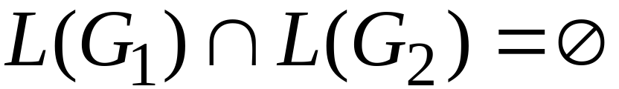


Some undecidable problems for
context-free languages:
Is ?
are context-free grammars
Is context-free grammar ambiguous?

Slide 45
We need a tool to prove that the previous
problems for context-free languages
are undecidable:
The Post Correspondence Problem

Slide 46
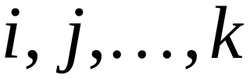
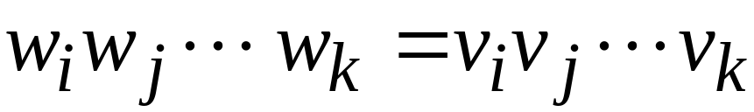
There is a Post Correspondence Solution
if there is a sequence such that:
PC-solution:
Indices may be repeated or omitted

Slide 47
Some undecidable problems for
context-free languages:
Is ?
are context-free grammars
Is context-free grammar ambiguous?

Slide 48

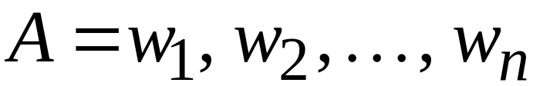
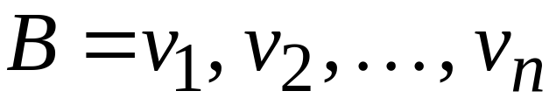
The Post Correspondence Problem
Input:
Two sets of strings

Slide 49
There is a Post Correspondence Solution
if there is a sequence such that:
PC-solution:
Indices may be repeated or omitted

Slide 50

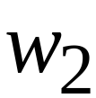
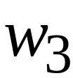










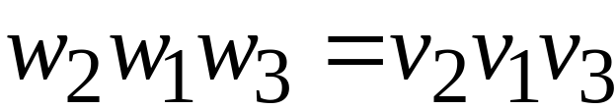

Example:
PC-solution:

Slide 51
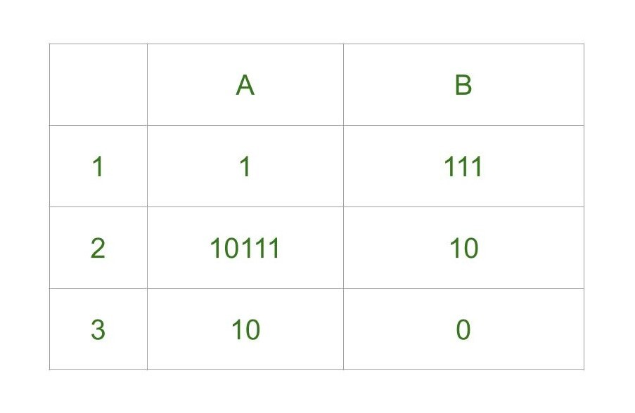
Example
w x
PC-solution:
2 1 1 3
w₂w₁w₁w₃= x₂x₁x₁x₃

Slide 52
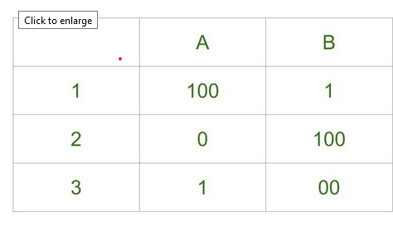
Example
w x
PC-solution:
problem does not have solution.

Slide 53
Example:
PC-solution:

Slide 54




Example:
There is no solution

Slide 55
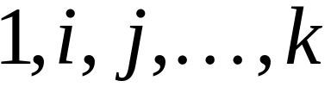
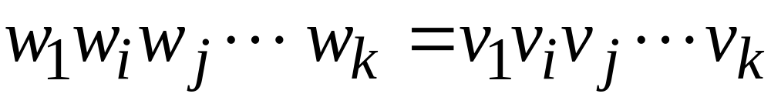
The Modified Post Correspondence Problem
Inputs:
MPC-solution:

Slide 56

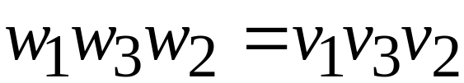
Example:
MPC-solution:

Slide 57
1. The MPC problem is undecidable
(by reducing the membership to MPC)
2. The PC problem is undecidable
(by reducing MPC to PC)

Slide 58
Theorem: The MPC problem is undecidable
Proof: By reducing the membership
problem to the MPC problem

Slide 59


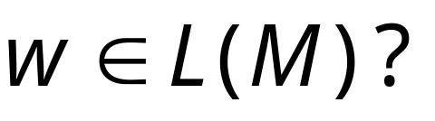
Membership problem
Input: Turing machine
string
Question:
Undecidable

Slide 60

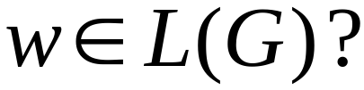
Membership problem
Input: unrestricted grammar
string
Question:
Undecidable

Slide 61


Suppose we have a decider for
the MPC problem
String Sequences
MPC solution?
YES
MPC problem
decider
NO

Slide 62
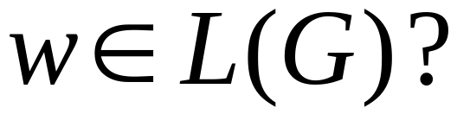


We will build a decider for
the membership problem
YES
Membership
problem
decider
NO

Slide 63
The reduction of the membership problem
to the MPC problem:
Membership problem decider
yes
yes
MPC problem
decider
no
no

Slide 64
We need to convert the input instance of
one problem to the other
Membership problem decider
yes
yes
MPC problem
decider
Reduction?
no
no

Slide 65
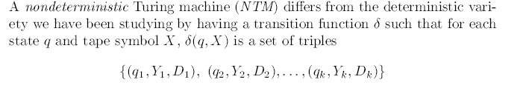
NDTM: Non deterministic Turing Machine

